Slide 1
Probabilistic PPM
Matthias Zwicker University of Bern, Switzerland

Slide 2
Probabilistic PPM
Alternative derivation of PPM
Fixed radius reduction, no need for statistics
Asymptotic convergence analysis
Trivial to implement
General radiance estimates (volumes, beams,…)
General kernels

Slide 3
Bias-variance trade-off
Larger kernels
Lower variance
Higher bias
Smaller kernels
Higher variance
Lower bias
Vanishing variance and bias
Infinitely many photons
Infinitely small kernels
Radiance estimation
Photons
Radiance estimation kernel

Slide 4
Progressive photon mapping
Breaking the variance-bias trade off
Basic algorithm
Iterate over photon mapping steps
Reduce kernel size in each step
Accumulate results
Advantages
Bias and variance vanish over iterations
Avoid memory bottleneck

Slide 5
Progressive photon mapping
What’s the right strategy to reduce kernel sizes?
Hachisuka et al. [SIGGRAPH Asia 2008]
Reduce kernel based on empirical statistics
Our approach [ACM TOG 2011]
“Blindly” reduce kernel by fixed factor

Slide 6
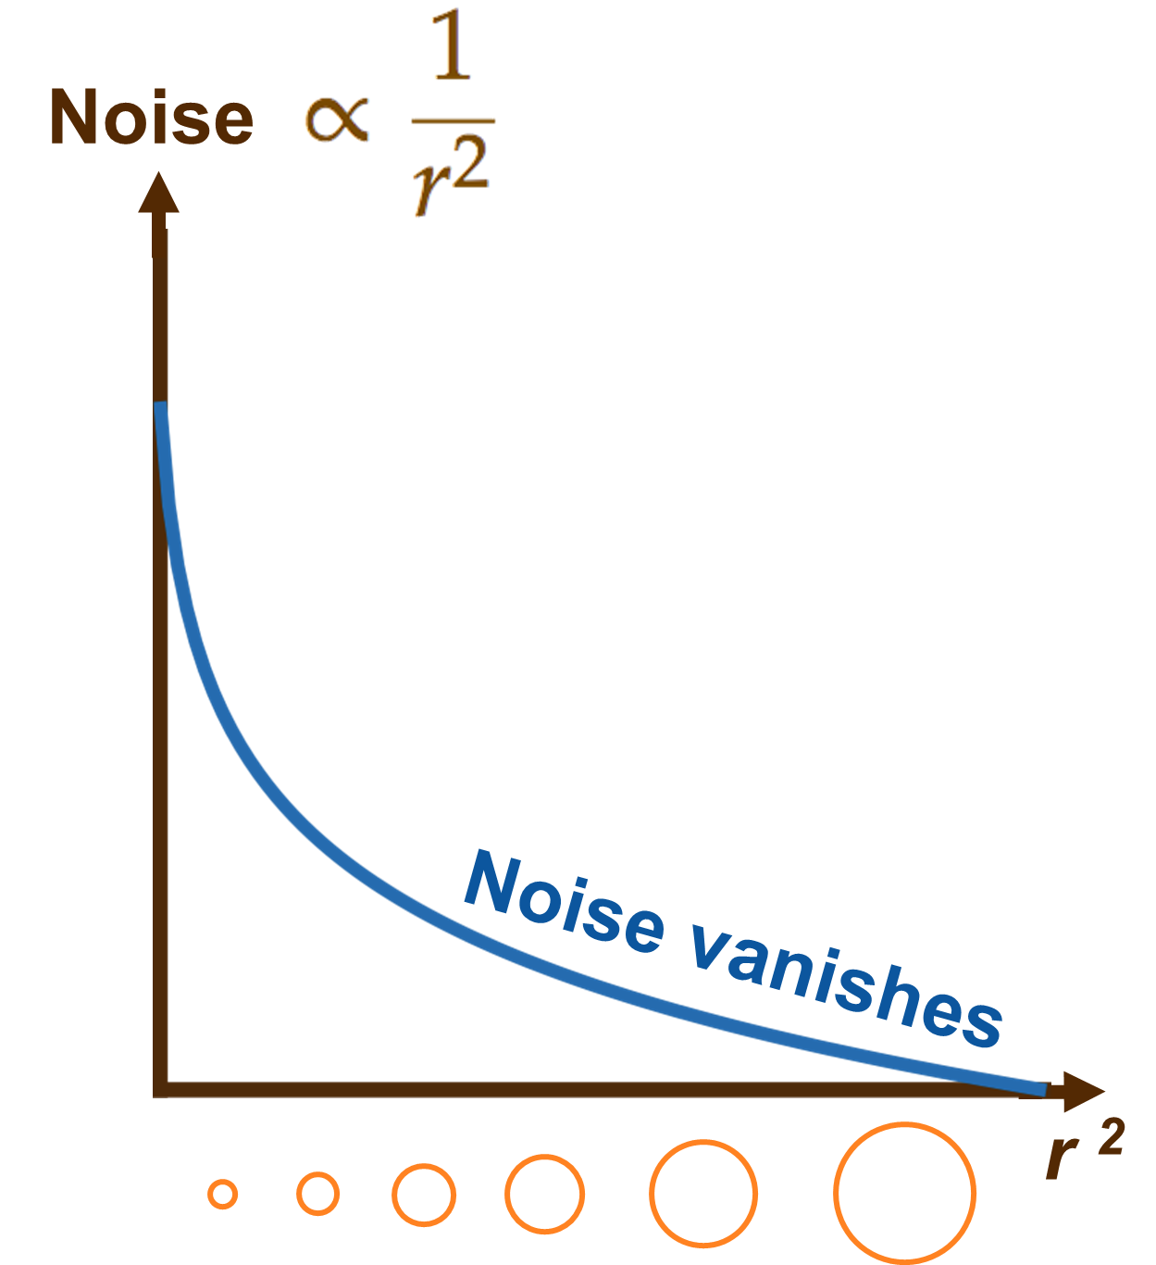
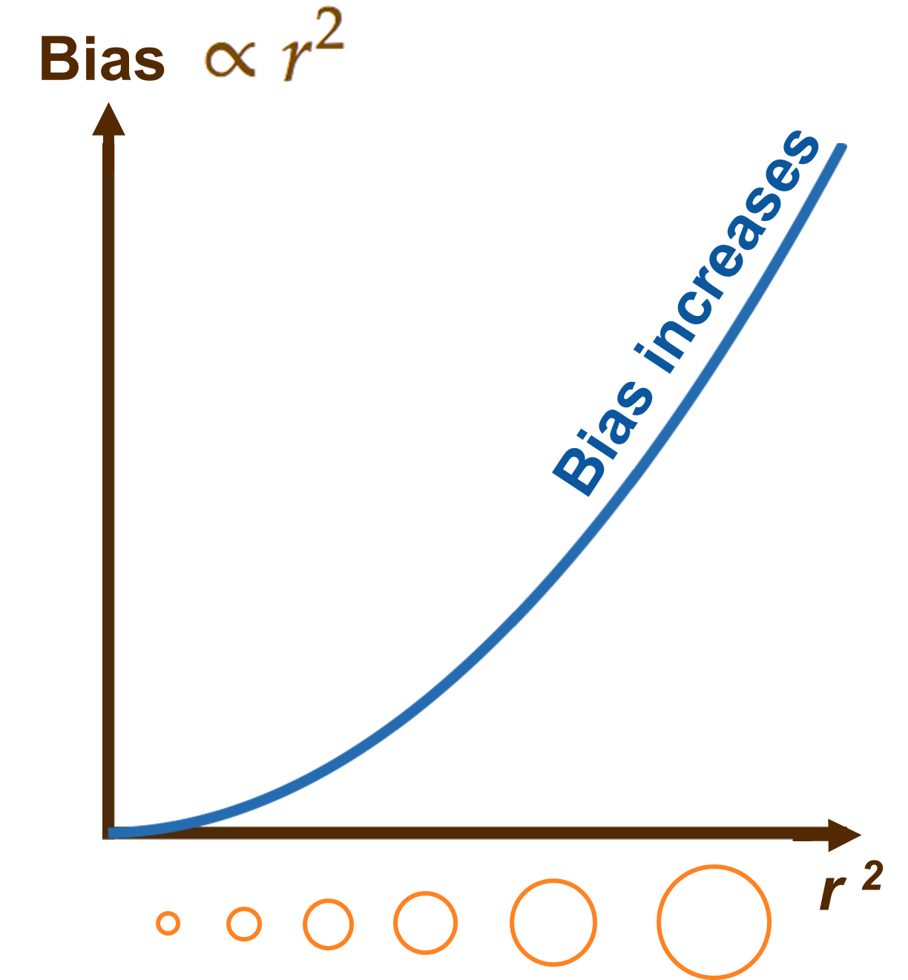
Probabilistic analysis
Consider output of radiance estimation as random variable

Slide 7
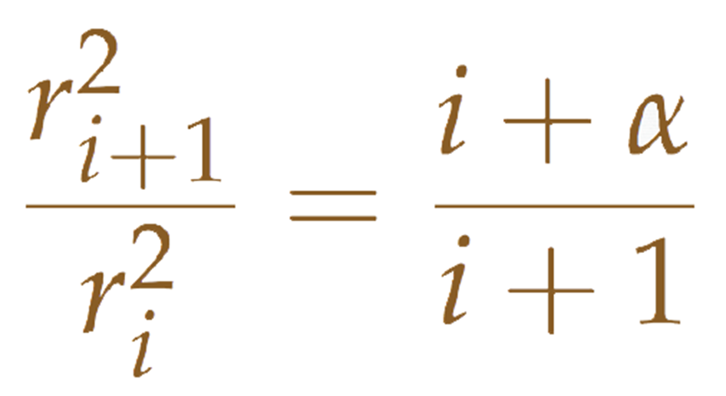
Radius reduction
Iteration step i
Radiance estimation radius r_{i}
Parameter 0 < α < 1
Theory and derivation [Knaus and Zwicker 2011]

Slide 8
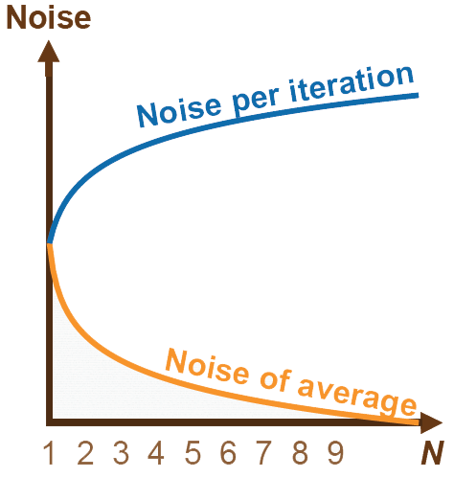
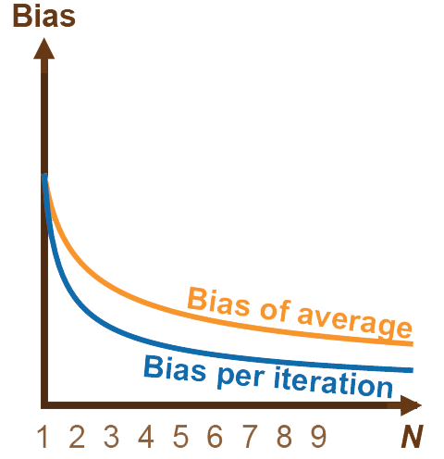
Convergence analysis
O(1/N^{1-α})
O(1/N^{α})

Slide 9
Radius reduction

Slide 10
Mean squared error (MSE)
MSE = Variance + Bias^2
Asymptotically, MSE = O(1/N^{α} + 1/N^{2-2α})
Minimize wrt. α: MSE = O(1/N^{2/3}) for α = 2/3

Slide 11
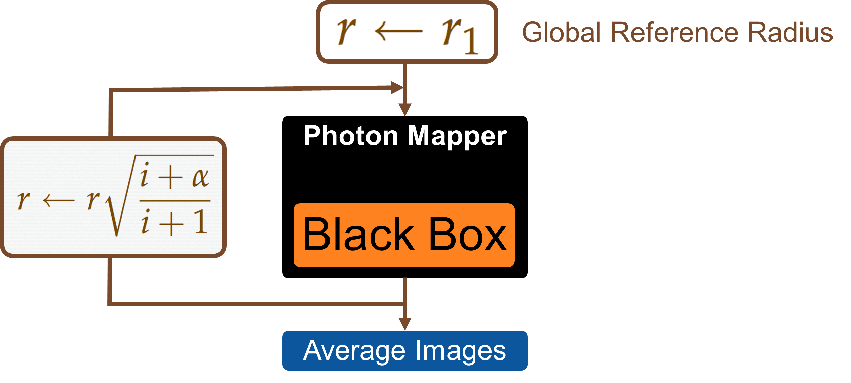
Implementation

Slide 12
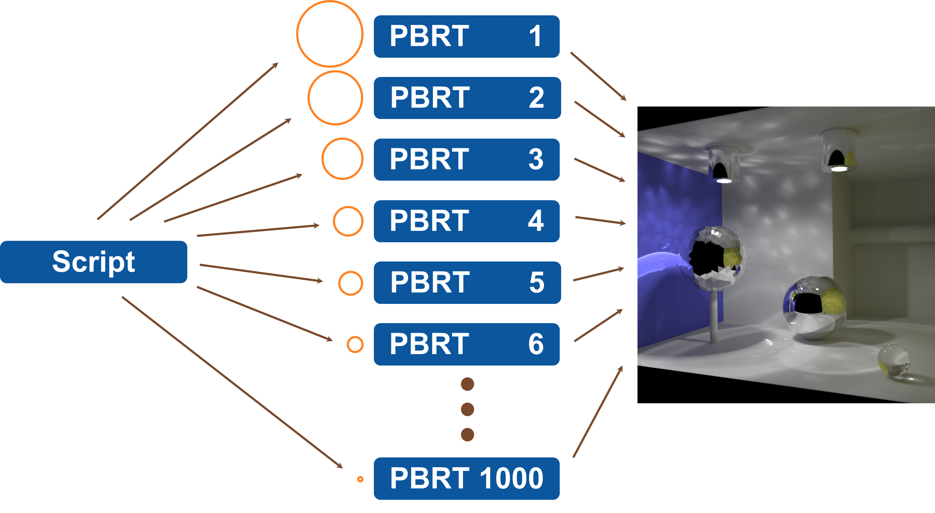
Implementation

Slide 13
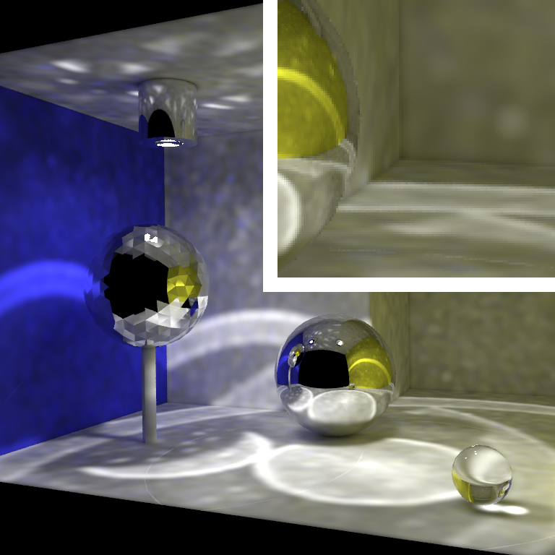
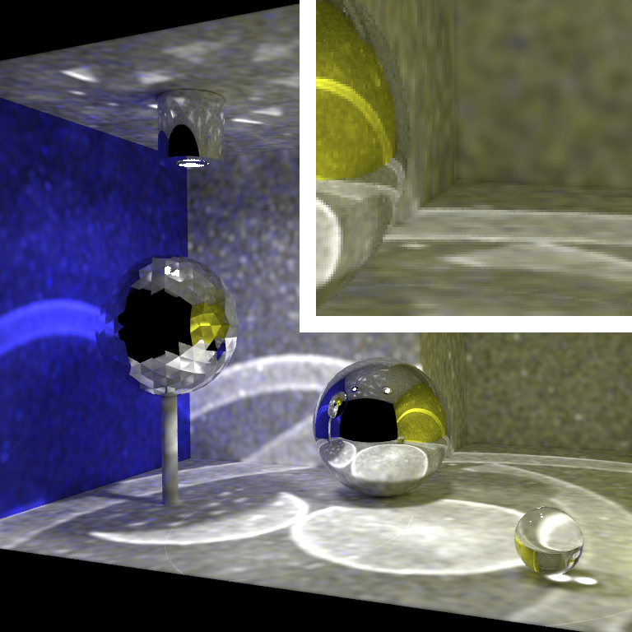
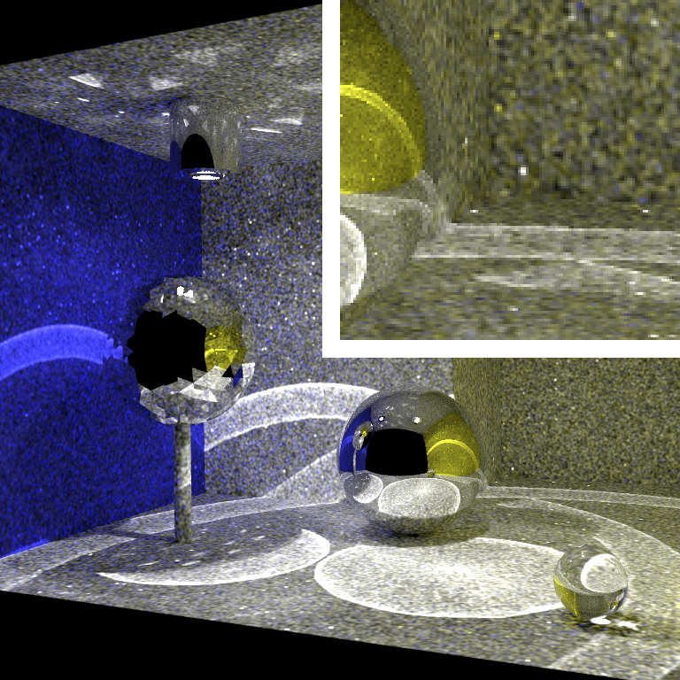
Image 1
Image 10
Image 100
Image 1000
Notes:
Here we see the results. As expected, the rendered images are noisier when the kernel radius is smaller.

Slide 14
1
1—10
1—100
1—1000
Notes:
But let’s see what happens when we average over the images. Here, we see just the first image. Now, the first 10 images averaged; already much less noise. Now, averaged over first 100 images. And finally, over 1000 images without visible noise or bias.

Slide 15
Arbitrary Kernels
Box
Gaussian
SIGGRAPH
Notes:
Our reformulation of progressive photon mapping is more general. We can use arbitrary kernels for radiance estimation. Let’s see what happens if we use the right most kernel.

Slide 16
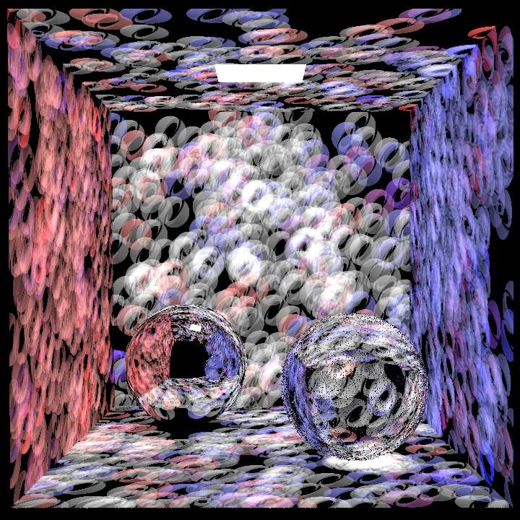
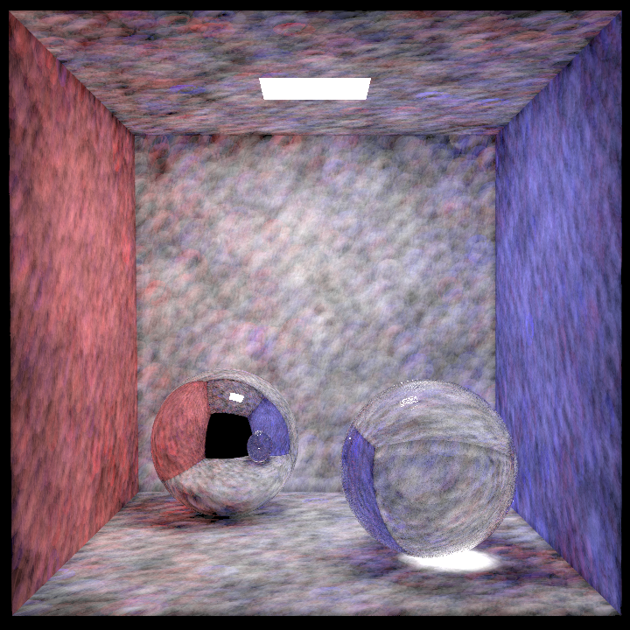
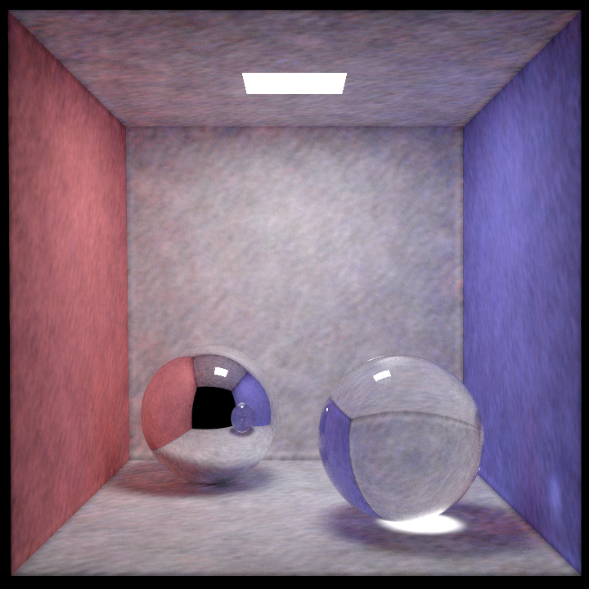
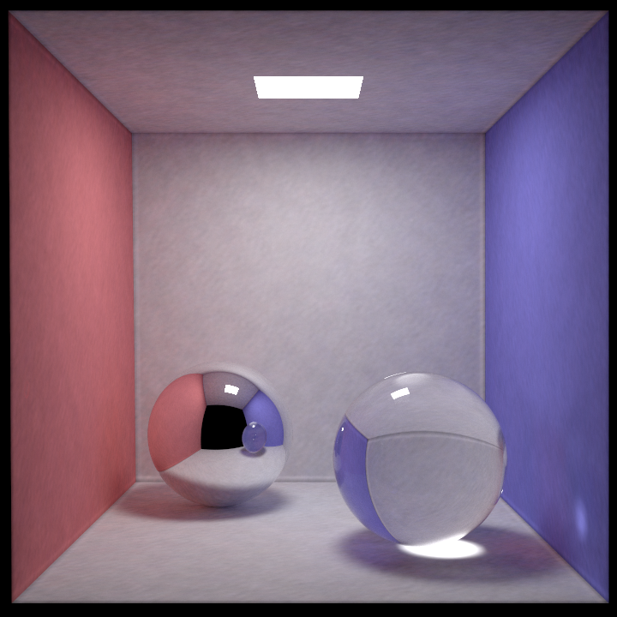
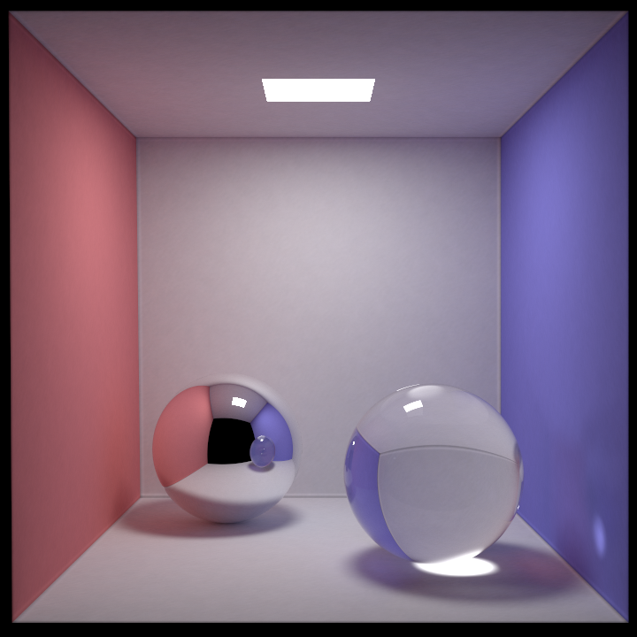
Notes:
Here, we use only one thousand photons per iteration to show the kernel. Well, even in this case, after many iterations, we observe that the image sequence converges.

Slide 17
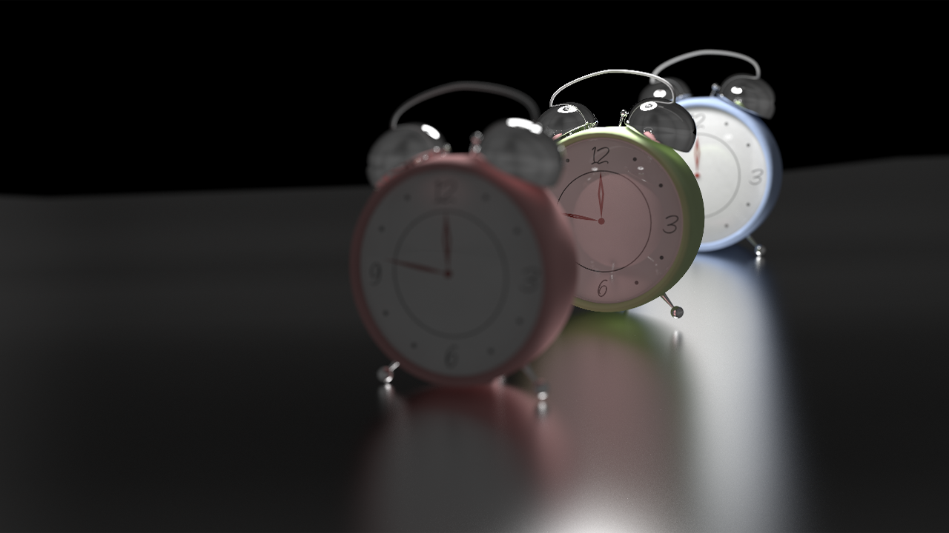
Stochastic Effects
Scene courtesy of Toshiya Hachisuka
Notes:
Just like stochastic PPM, our method includes stochastic effects as well. We demonstrate here depth of field and glossy surfaces.

Slide 18
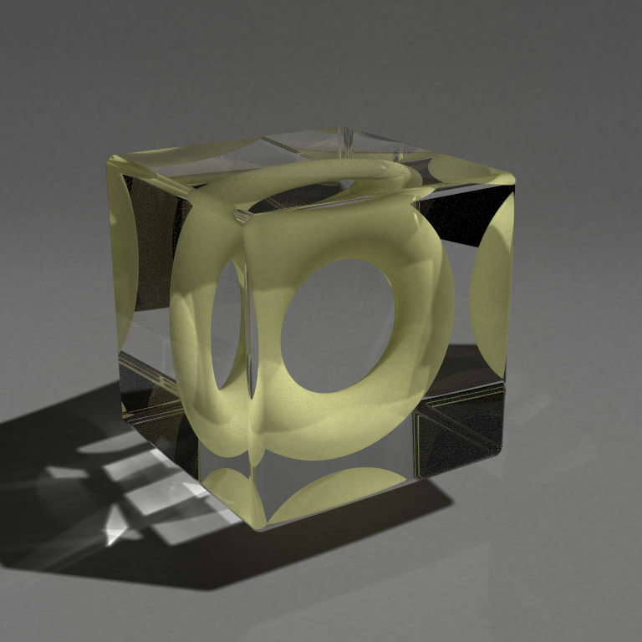
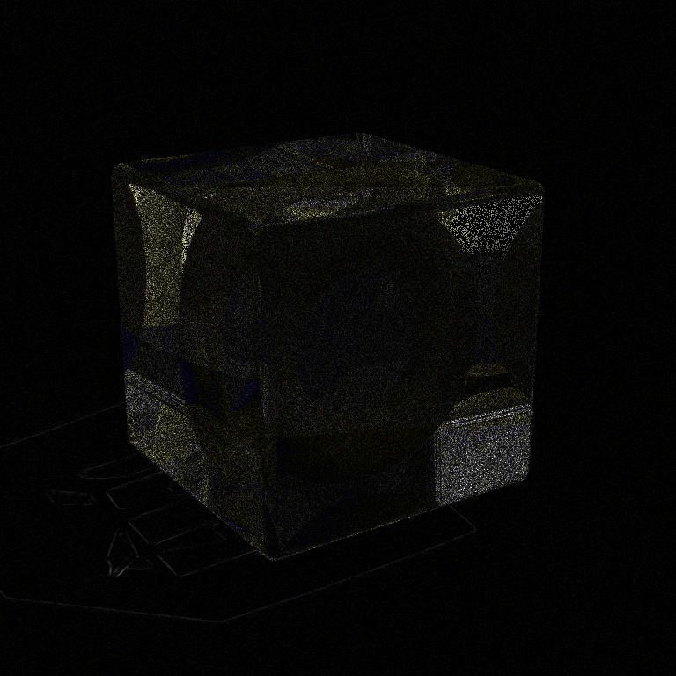
Stochastic PPM
Our method
20x Difference
Scene courtesy of Toshiya Hachisuka
Notes:
Quality-wise, our method stands on equal foot with traditional progressive photon mapping. Here we used a global reference radius for both methods. The difference between using traditional progressive photon mapping and our method is only in the noise.

Slide 19
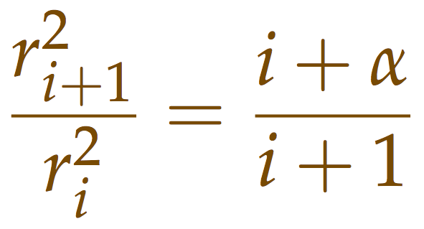
Participating media
✗
✗

Slide 20
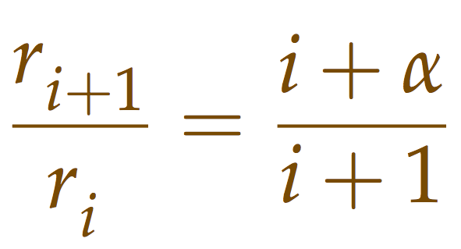
Participating media
3
3

Slide 21
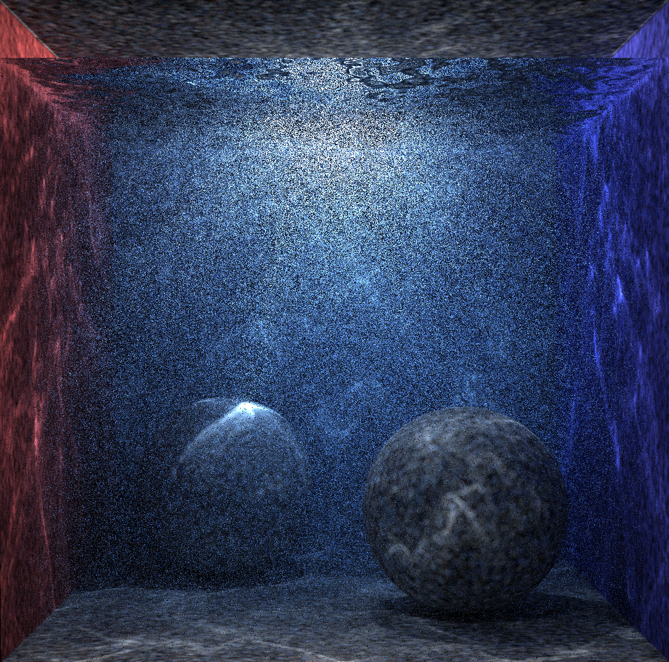
1 iteration
2 million photons
Notes:
Here is a an example. This is a cornell box filled with water. At the beginning, with only 2 million photons, we only see noise.

Slide 22
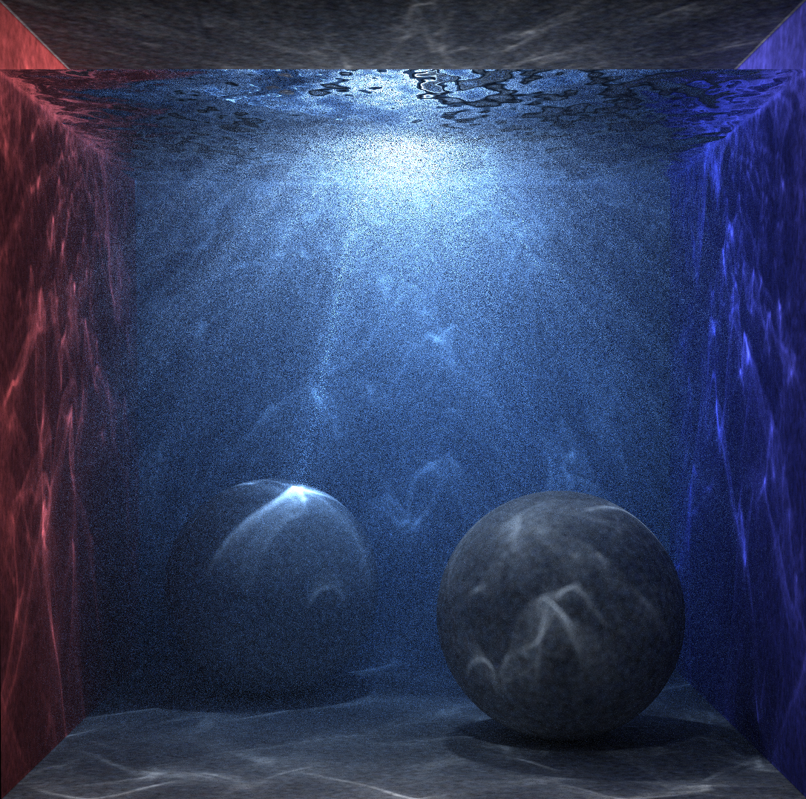
10 iterations
20 million photons
Notes:
But if we shoot enough photons

Slide 23
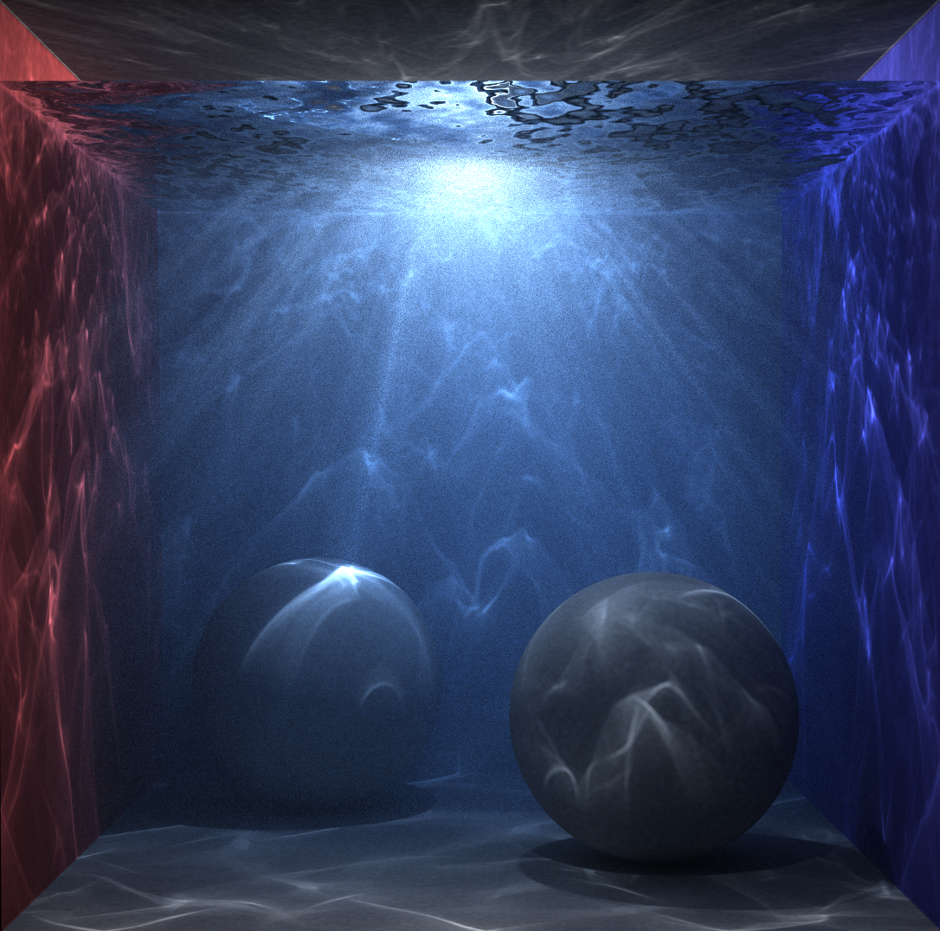
100 iterations
200 million photons
Notes:
we start seeing god rays.

Slide 24
1000 iterations
2 billion photons
Notes:
And eventually, after 1000 iterations and 2 billion photons, sharp caustics appear and the noise is gone.

Slide 25
Conclusions
Progressive photon mapping without statistics
Simple radius update
Asymptotic convergence analysis
Trivial implementation
Applicable to arbitrary kernels
Generalizable to volumes, beams [Jarosz et al. 2011]

